Slide 1
Software Engineering/Professional Practice and BUS Dr. Rami Bahsoon School of Computer Science University of Birmingham r.bahsoon@cs.bham.ac.uk
Introduction to Software Architecture and Styles

Slide 2
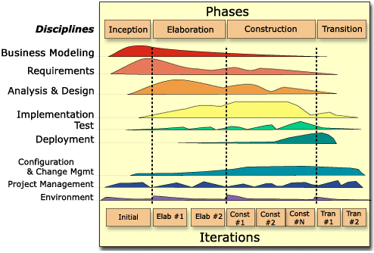
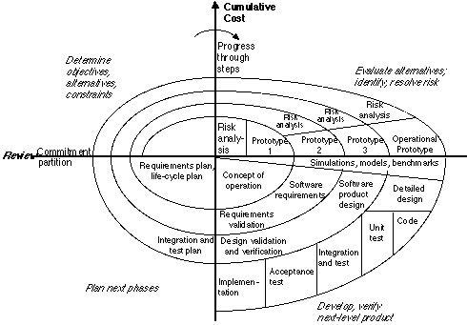
Last lectures

Slide 3
Software Architecture
A software architecture is an abstraction of a system:
The software components and connectors
The externally visible properties of those components
The relationships among the components and the environment
Externally-visible properties of elements are assumptions that one elements can make about another:
provided services, required services, performance characteristics, fault handling, resource usage etc.

Slide 4
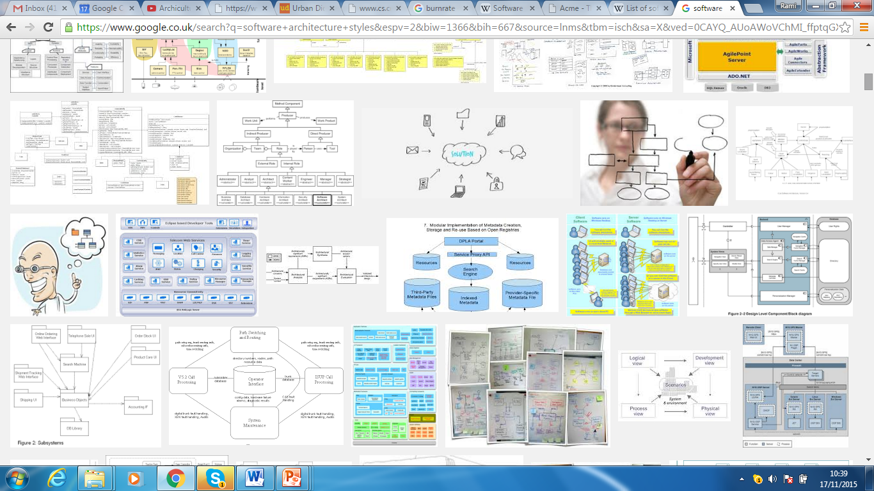

Slide 5
Quality Attributes and Architecture Decisions
Performance
Localise critical operations and minimise communications. Use large rather than fine-grain components.
Security
Use a layered architecture with critical assets in the inner layers.
Safety
Localise safety-critical features in a small number of sub-systems.
Availability
Include redundant components and mechanisms for fault tolerance.
Maintainability
Use fine-grain, replaceable components.

Slide 6
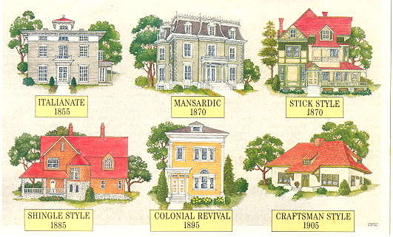

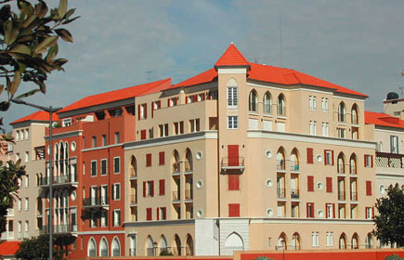
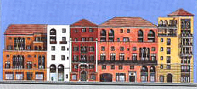
Analogy….

Slide 7
Quality Attributes: Dimensions of Dependability

Slide 8
Other Dependability Properties
Repairability
Reflects the extent to which the system can be repaired in the event of a failure
Maintainability
Reflects the extent to which the system can be adapted to new requirements;
Survivability
Reflects the extent to which the system can deliver services whilst under hostile attack;
Error tolerance
Reflects the extent to which user input errors can be avoided and tolerated.

Slide 9
Architectural Tradeoffs and conflicts
Using large-grain components improves performance but reduces maintainability.
Introducing redundant data improves availability but makes security more difficult.
Localising safety-related features usually means more communication so degraded performance.

Slide 10
Architecture Design Decisions
Is there a generic application architecture that can be used?
How will the system be distributed?
What architectural styles are appropriate?
What approach will be used to structure the system?
How will the system be decomposed into modules?
What control strategy should be used?
How will the architectural design be evaluated?
How should the architecture be documented?

Slide 11
Architectural Styles
The architectural model of a system may conform to a generic architectural model or style.
An awareness of these styles can simplify the problem of defining system architectures.
However, most large systems are heterogeneous and do not follow a single architectural style.
Documented as architectural patterns

Slide 12
Architectural Styles
Reflects the basic strategy that is used to structure a system.
Several Examples:
Component-based, Monolithic application aka "Big Ball of Mud" style, Layered, Pipes and filters, Shared memory, Data-centric, Blackboard, Rule-based, Messaging, Event-driven, Publish-subscribe, Asynchronous messaging, Client-server (2-tier, 3-tier, n-tier exhibit this style), Object request broker, Peer-to-peer, Representational state transfer, Service-oriented etc. etc.

Slide 13
The Repository/Blackboard Style
Sub-systems must exchange data. This may be done in two ways:
Shared data is held in a central database or repository and may be accessed by all sub-systems;
Each sub-system maintains its own database and passes data explicitly to other sub-systems.
When large amounts of data are to be shared, the repository model of sharing is most commonly used.
Two kinds of components
Central data structure — blackboard
Components operating on the blackboard
System control is entirely driven by the blackboard state

Slide 14
Example: CASE toolset architecture

Slide 15
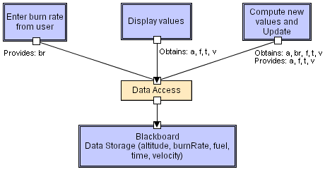
Another Example: Blackboard
Software Architecture: Foundations, Theory, and Practice; Richard N. Taylor, Nenad Medvidovic, and Eric M. Dashofy; © 2008 John Wiley & Sons, Inc. Reprinted with permission.

Slide 16
Blackboard style characteristics
Advantages
Efficient way to share large amounts of data;
Sub-systems need not be concerned with how data is produced Centralised management e.g. backup, security, etc.
Sharing model is published as the repository schema.
Disadvantages
Sub-systems must agree on a repository data model. Inevitably a compromise;
Data evolution is difficult and expensive;
No scope for specific management policies;
Difficult to distribute efficiently.

Slide 17
Client-Server model
Distributed system model which shows how data and processing is distributed across a range of components.
Set of stand-alone servers which provide specific services such as printing, data management, etc.
Set of clients which call on these services.
Components are clients and servers
Servers do not know number or identities of clients
Clients know server’s identity
Network which allows clients to access servers.

Slide 18
Client Server Model

Slide 19
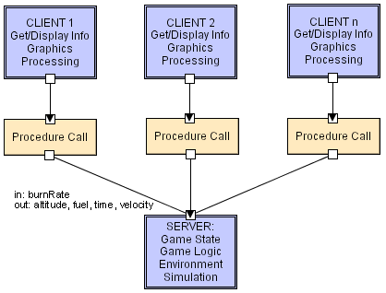
Client-Server LL
Software Architecture: Foundations, Theory, and Practice; Richard N. Taylor, Nenad Medvidovic, and Eric M. Dashofy;

Slide 20
Client-server characteristics
Advantages
Distribution of data can be straightforward;
Makes effective use of networked systems.
Easy to add new servers or upgrade existing servers.
Disadvantages
No shared data model so sub-systems use different data organisation. Data interchange may be inefficient;
Redundant management in each server;
No central register of names and services - it may be hard to find out what servers and services are available.

Slide 21
Layered/Abstract machine model
Organises the system into a set of layers (or abstract machines) each of which provide a set of services.
Supports the incremental development of sub-systems in different layers.
Hierarchical system organization
“Multi-level client-server”
Each layer exposes an interface (API) to be used by above layers
Each layer acts as a
Server: service provider to layers “above”
Client: service consumer of layer(s) “below”
Connectors are protocols of layer interaction
However, often artificial to structure systems in this way.

Slide 22
Version management system

Slide 23
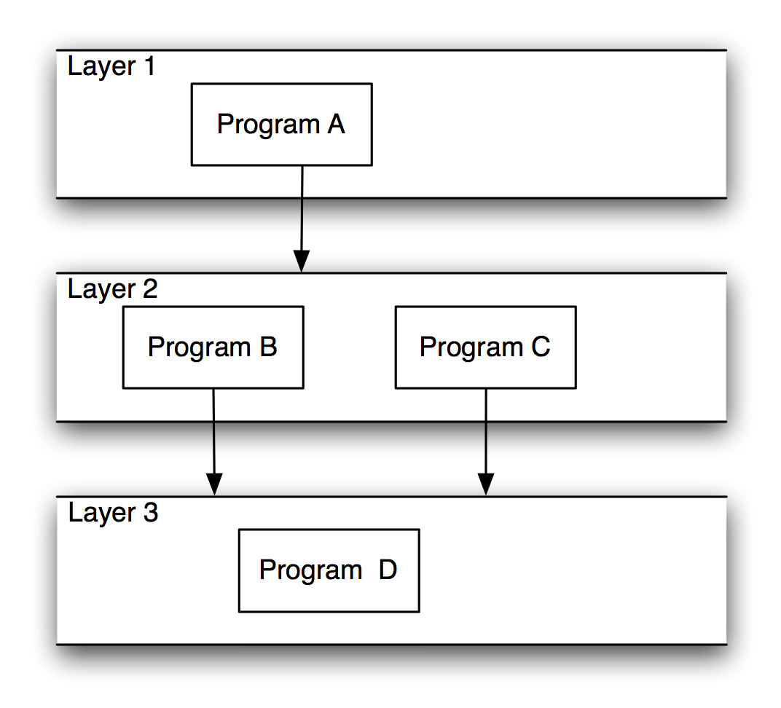
Layered Systems/Virtual Machines
Software Architecture: Foundations, Theory, and Practice; Richard N. Taylor, Nenad Medvidovic, and Eric M. Dashofy;

Slide 24
Layered Style
Advantages
Increasing abstraction levels
Evolvability
Changes in a layer affect at most the adjacent two layers
Reuse
Different implementations of layer are allowed as long as interface is preserved
Standardized layer interfaces for libraries and frameworks

Slide 25
Layered Style (cont’d)
Disadvantages
Not universally applicable
Performance
Layers may have to be skipped
Determining the correct abstraction level

Slide 26
Pipe and Filter Style
Components are filters
Transform input data streams into output data streams
Possibly incremental production of output
Connectors are pipes
Conduits for data streams
Style invariants
Filters are independent (no shared state)

Slide 27
Pipe and Filter (cont’d)
Variations
Pipelines — linear sequences of filters
Bounded pipes — limited amount of data on a pipe
Typed pipes — data strongly typed
Advantages
System behavior is a succession of component behaviors
Filter addition, replacement, and reuse
Possible to hook any two filters together
Certain analyses
Throughput, latency, deadlock
Concurrent execution

Slide 28
Pipe and Filter (cont’d)
Disadvantages
Batch organization of processing
Interactive applications
Lowest common denominator on data transmission

Slide 29

Pipe and Filter LL
Software Architecture: Foundations, Theory, and Practice; Richard N. Taylor, Nenad Medvidovic, and Eric M. Dashofy;
Notes:
GetBurnRate runs continuously on its own, prompting the user for a new burn rate.
In this design the “compute new values” determines how much time has passed. Could alternatively do that in the GetBurnRate filter. Would change semantics a bit.

Slide 30
Publish-Subscribe
Subscribers register/deregister to receive specific messages or specific content.
Publishers broadcast messages to subscribers either synchronously or asynchronously.

Slide 31
Publish-Subscribe (cont’d)
Components: Publishers, subscribers, proxies for managing distribution
Connectors: Typically a network protocol is required. Content-based subscription requires sophisticated connectors.
Data Elements: Subscriptions, notifications, published information
Topology: Subscribers connect to publishers either directly or may receive notifications via a network protocol from intermediaries
Qualities yielded Highly efficient one-way dissemination of information with very low-coupling of components

Slide 32
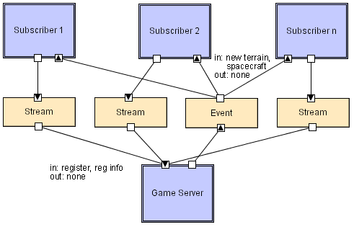
Pub-Sub LL
Software Architecture: Foundations, Theory, and Practice; Richard N. Taylor, Nenad Medvidovic, and Eric M. Dashofy; © 2008 John Wiley & Sons, Inc. Reprinted with permission.

Slide 33
Event-Based Style
Independent components asynchronously emit and receive events communicated over event buses
Components: Independent, concurrent event generators and/or consumers
Connectors: Event buses (at least one)
Data Elements: Events – data sent as a first-class entity over the event bus
Topology: Components communicate with the event buses, not directly to each other.
Variants: Component communication with the event bus may either be push or pull based.
Highly scalable, easy to evolve, effective for highly distributed applications.

Slide 34
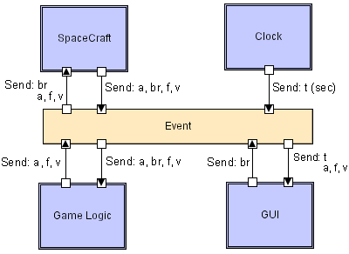
Event-based LL
Software Architecture: Foundations, Theory, and Practice; Richard N. Taylor, Nenad Medvidovic, and Eric M. Dashofy; © 2008 John Wiley & Sons, Inc. Reprinted with permission.

Slide 35
Peer-to-Peer Style
Peers: independent components, having their own state and control thread.
State and behavior are distributed among peers which can act as either clients or servers.
Connectors: Network protocols
Data Elements: Network messages

Slide 36
Peer-to-Peer Style (cont’d)
Topology: Network (may have redundant connections between peers); can vary arbitrarily and dynamically
Supports decentralized computing with flow of control and resources distributed among peers.
Highly robust in the face of failure of any given node.
Scalable in terms of access to resources and computing power.

Slide 37
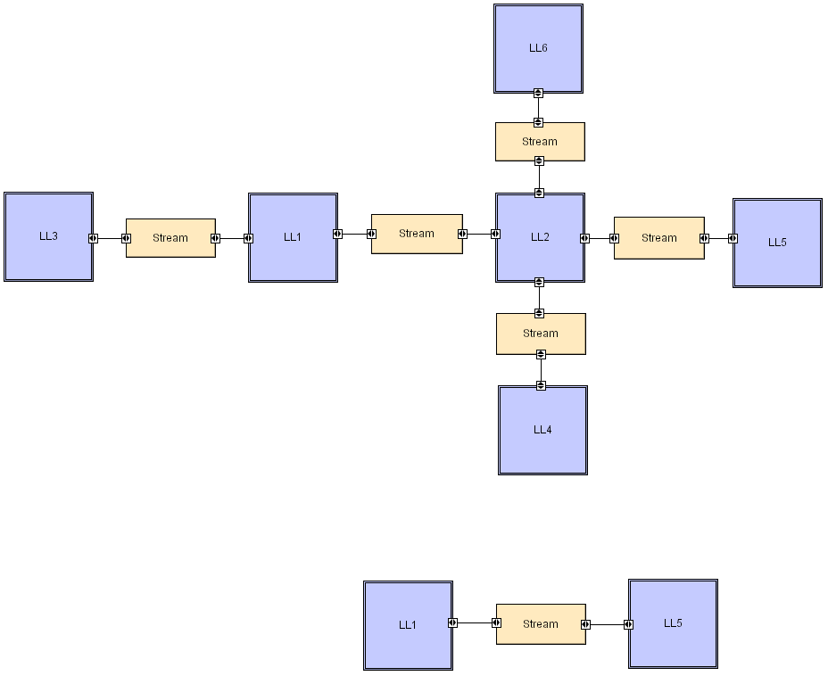
Peer-to-Peer LL
Software Architecture: Foundations, Theory, and Practice; Richard N. Taylor, Nenad Medvidovic, and Eric M. Dashofy; © 2008 John Wiley & Sons, Inc. Reprinted with permission.

Slide 38
Data-Flow Styles
Batch Sequential
Separate programs are executed in order; data is passed as an aggregate from one program to the next.
Connectors: “The human hand” carrying tapes between the programs, a.k.a. “sneaker-net ”
Data Elements: Explicit, aggregate elements passed from one component to the next upon completion of the producing program’s execution.
Typical uses: Transaction processing in financial systems.

Slide 39
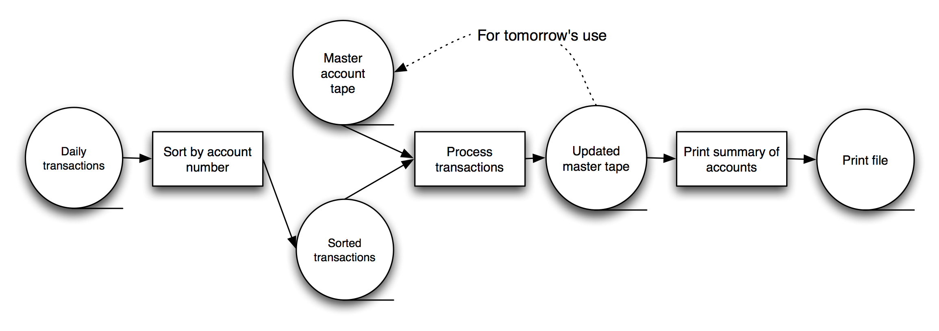
Batch-Sequential: A Financial Application
Software Architecture: Foundations, Theory, and Practice; Richard N. Taylor, Nenad Medvidovic, and Eric M. Dashofy; © 2008 John Wiley & Sons, Inc. Reprinted with permission.

Slide 40
Architecture Description Languages(ADLs)
e.g.,
http://www.cs.cmu.edu/~acme/

Slide 41
Architecture Reuse
Systems in the same domain often have similar architectures that reflect domain concepts.
Application product lines are built around a core architecture with variants that satisfy particular customer requirements.
Architecture Product Lines.

Slide 42
References
Software Engineering, Ian Somerville
The Software Architecture: Foundations, Theory, and Practice: Richard N. Taylor, Nenad Medvidović, and Eric M. Dashofy
Garlan and Shaw: https://www.cs.cmu.edu/afs/cs/project/able/ftp/intro_softarch/intro_softarch.pdf

